Slide 1
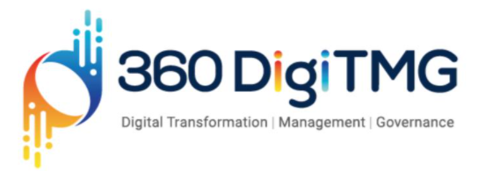

Digitizing Patient Experience using Analytics

Slide 2
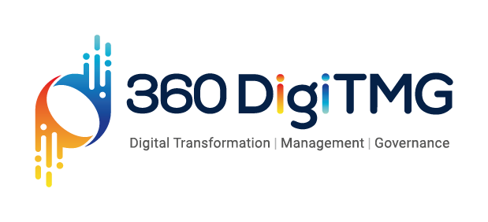


Ashner Gerald Plasabas Novilla
Regional Operations Maintenance and Test Engineer
https://www.linkedin.com/in/ashner-gerald-novilla/

Slide 3


Project Goals
This study aimed at analyzing the performance of forecasting models in predicting the number of patients coming to the Max Healthcare Hospital in terms of daily visits. Forecasting is one of the first steps in planning. The success of the plans depends on the accuracy, veracity, and precision of the forecasts. In the service industries like the hospitals, there are many plans that depend on the forecast, from capacity planning to aggregate planning, from layout decisions to the daily schedules. The accuracy of the forecasts could be determined by the error indicators after the trial of the many methods that fits our data.
Objectives
Constraints
Maximize forecasting models in predicting the number of patients coming to the hospital.
Maximize Max Healthcare Hospital's benefits
Maximize the liveliness and experience of the patients coming to the Max Healthcare Hospital
Maximize efficiency and effectivity in handling the patients
Minimize care fragmentation of the patients
Minimize inefficient queuing at Hospital
Minimize wrong timing visits of the patients
Minimize overloaded work for the hospital staffs

Slide 4
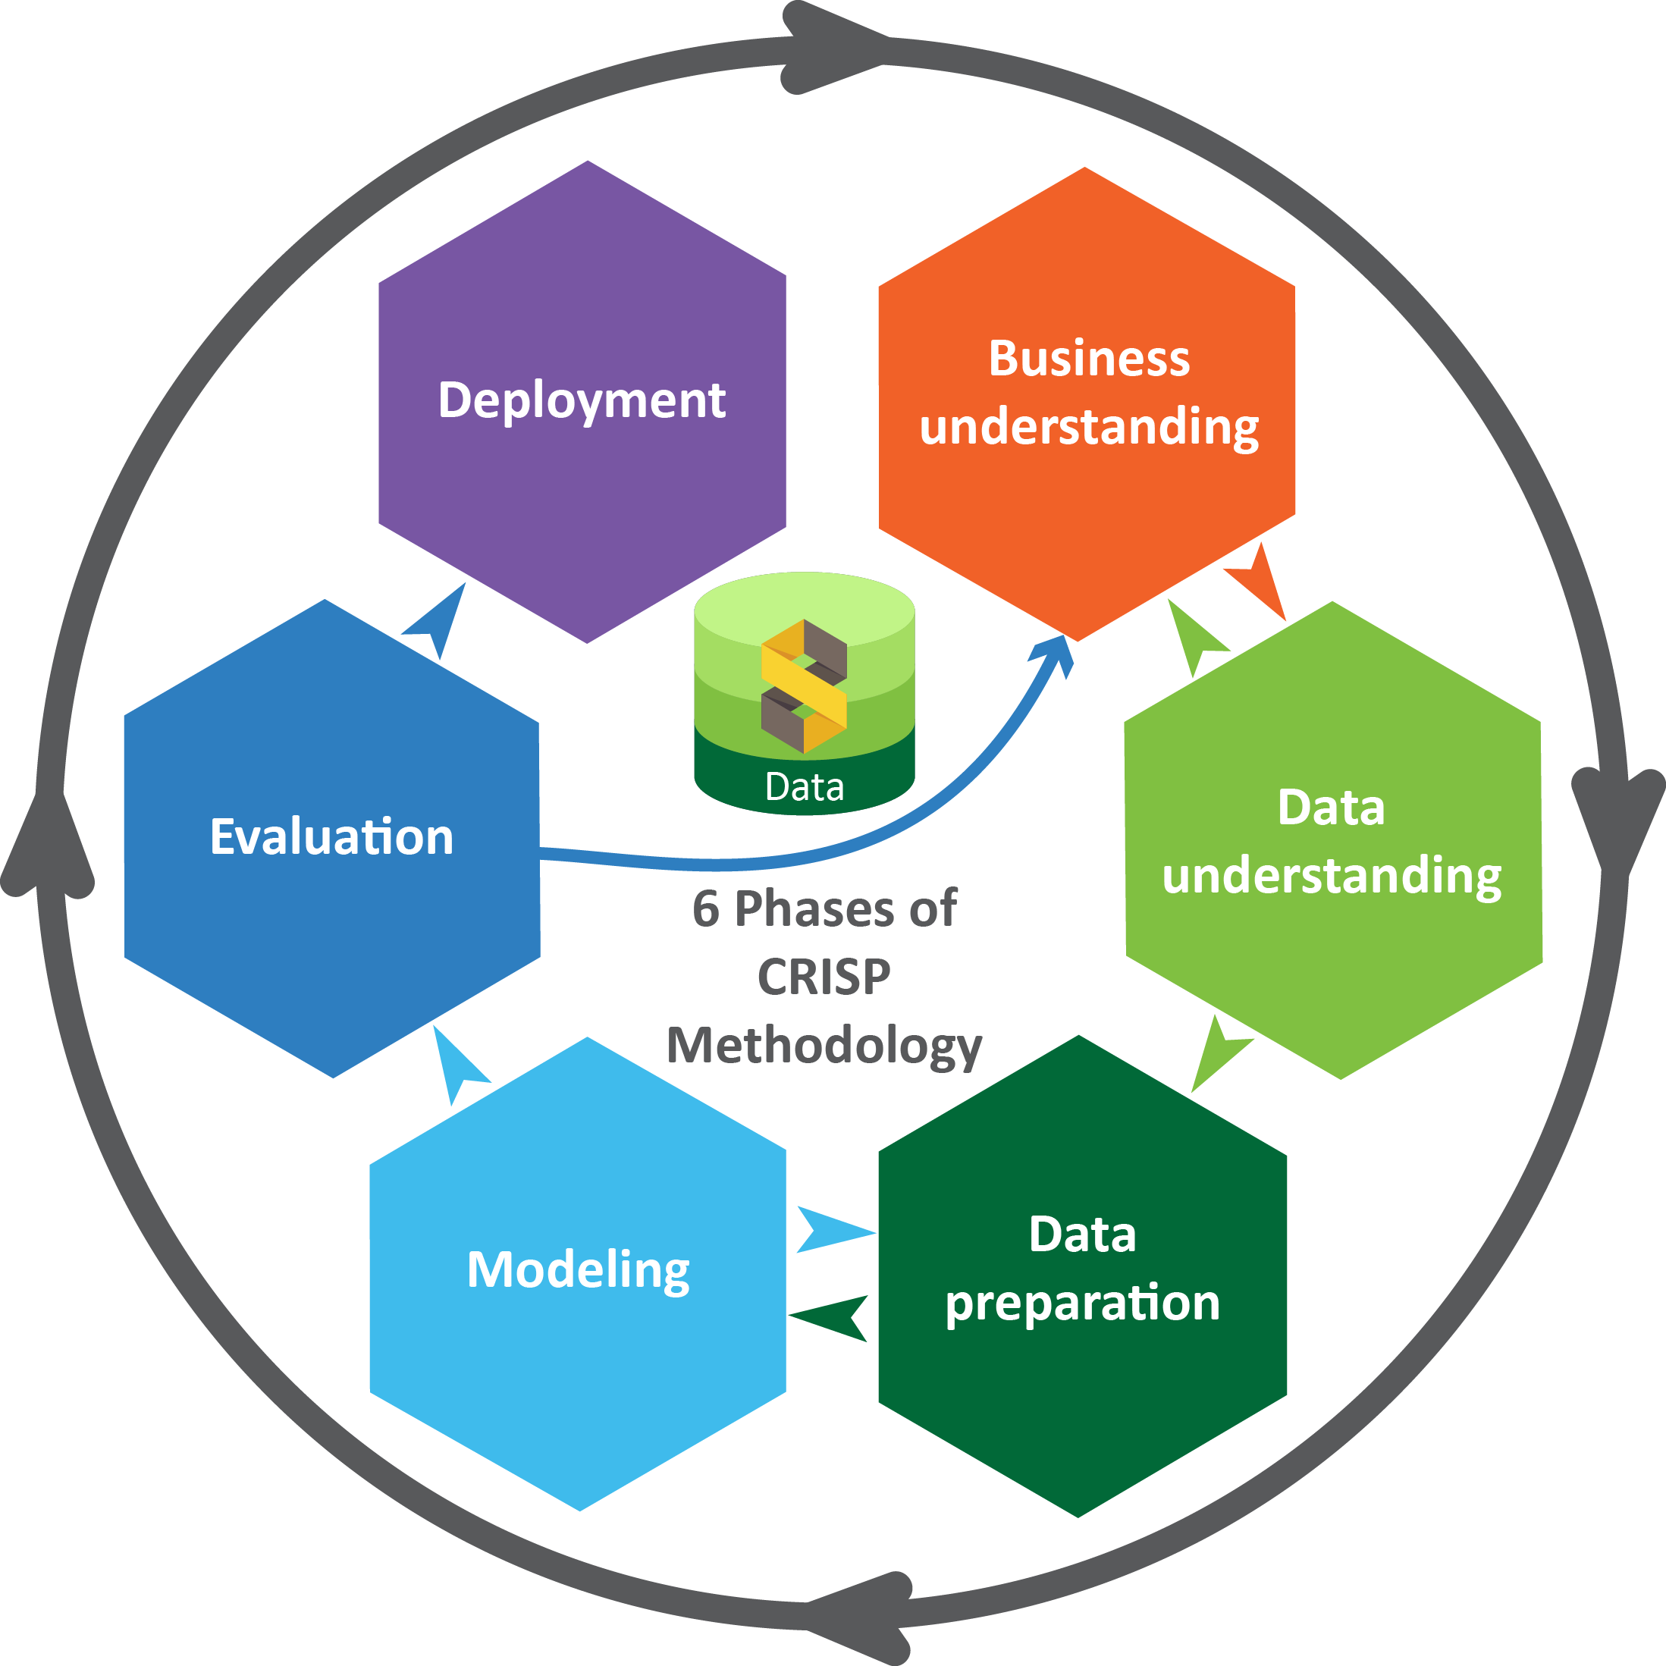
Business pipeline: CRISP-DM Methodology

Slide 5
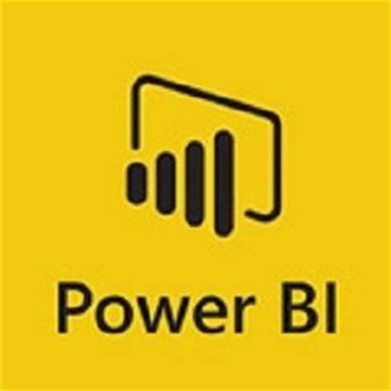


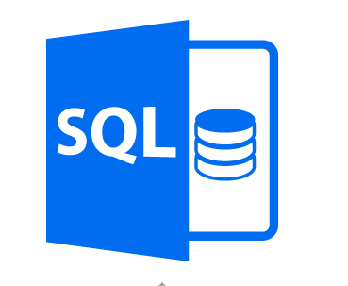


Technical Stacks
The tools that the researcher used are the following:
PowerBI
MySQL
Cloud
R Programming
Anaconda
Python (The Following Libraries had been used)
matplotlib 3.4.1
matplotlib-base 3.4.1
numpy 1.20.2
seaborn 0.10.1
statsmodels 0.12.0
fbprophet 0.7.1
pycaret 2.3.1

Slide 6


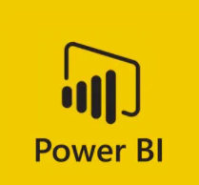

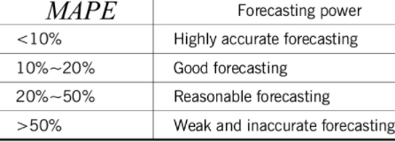

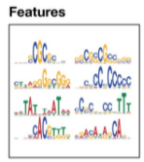
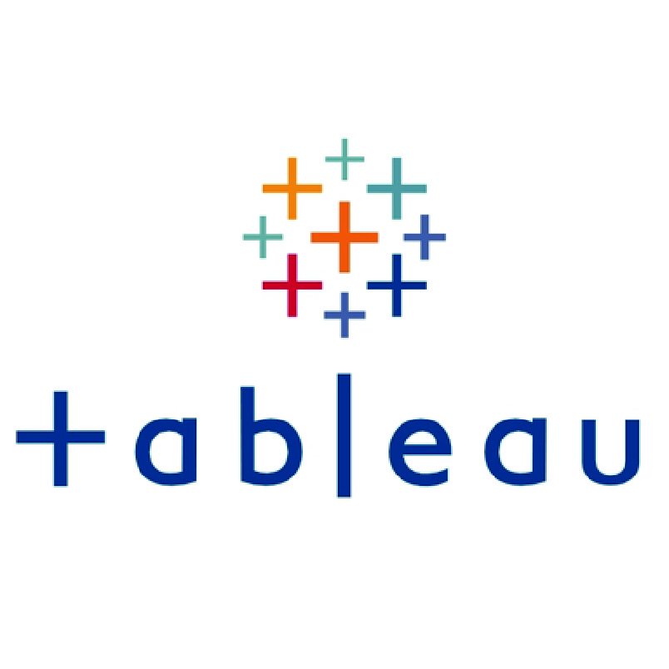
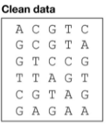
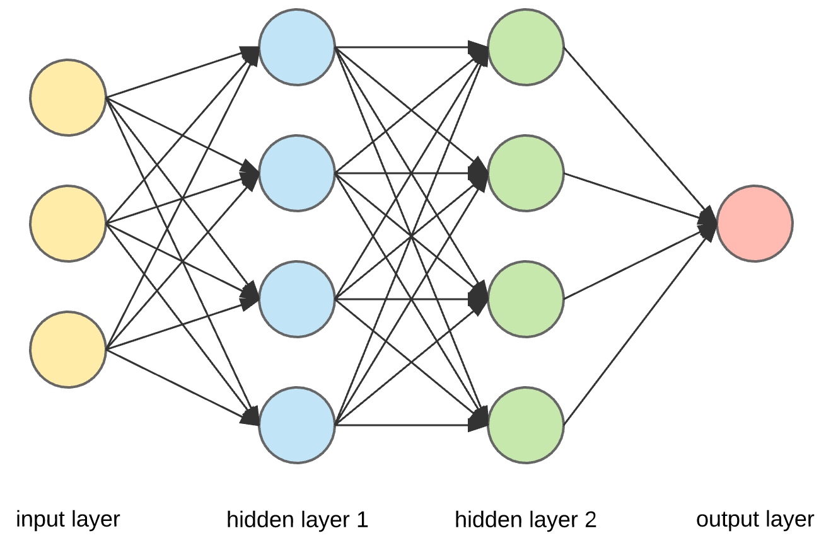
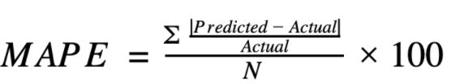
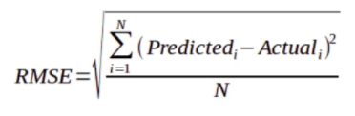
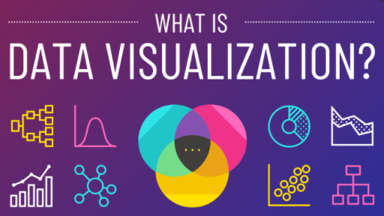
Project Architecture / Data Pipeline
Data Preparation
Feature Engineering
Model Generation
Model Evaluation
Data Visualization
Data Collection
Data Cleaning
Feature Extraction
Feature Selection
Feature Construction
Model Selection
Hyperparameter Optimization
MAPE Analysis
RMSE Analysis
MSE Analysis
PowerBI
Matplotlib
Tableau

Slide 7
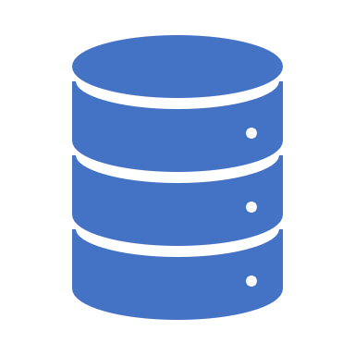
Data Preparation
Prophet, or “Facebook Prophet,” is an open-source library for univariate (one variable) time series forecasting developed by Facebook. Prophet models use the data to make in-sample and out-of-sample forecasts.
Prophet implements what they refer to as an additive time series forecasting model, and the implementation supports trends, seasonality, and holidays.
Additional steps for data preparation
Prophet requires data to be in Pandas Data Frames. Therefore, we will load and summarize the data using Pandas.
Create some time series features to see how the trends are impacted by day of week, hour, time of year, etc.
Plotting a time series helps us actually see if there is a trend, a seasonal cycle, outliers, and more. It gives us a feel for the data.Explain how you handled missing values
Impute the Holiday and missing values using mean imputation.
Cut off the data after 75% to use as our training set and use the remaining 25% for test data.
Compare forecast to actual values

Slide 8

Model Building

Slide 9
Model Description
Algorithms used:
FBProphet
ARIMA
AUTO Regression
Descriptions:
Split the data into training (75%) & testing (25%).
ARIMA Model Values = (7,1,7 [pdq])
The researcher used the FBProphet as the main forecasting model because it provides intuitive parameters which are easy to tune. Even someone who lacks deep expertise in time-series forecasting models can use this to generate meaningful predictions for a variety of problems in business scenarios.

Slide 10
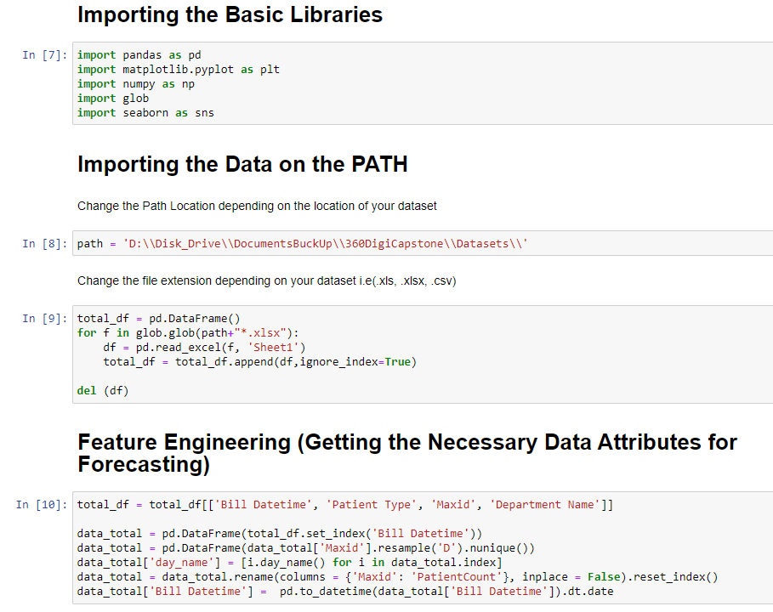
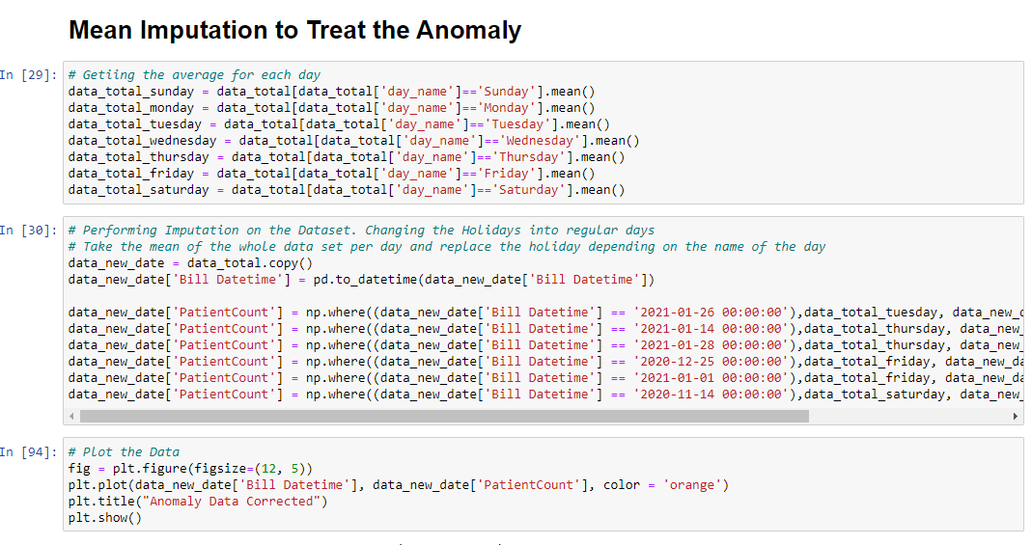
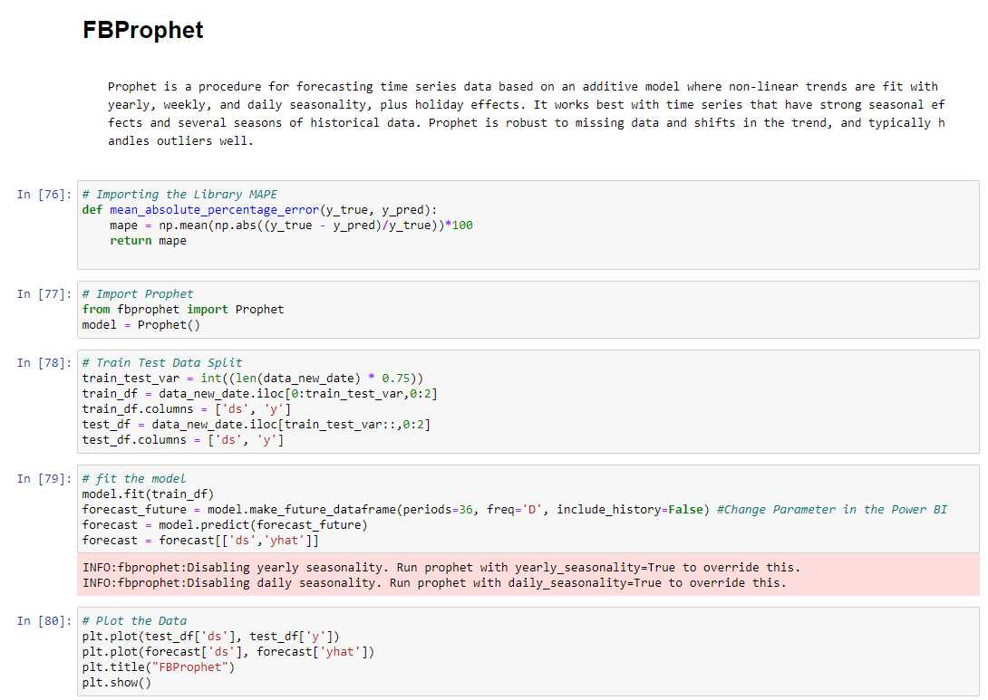
Outputs of the Model in Codes

Slide 11
Comparison of Model Performance
Models | FBProphet | AUTO Regression | ARIMA
MAPE | 9.62% MAPE | 9.72% MAPE | 16.15% MAPE
Performance | 2 Seconds | 2 Seconds | 2 Seconds

Slide 12

Deployment Strategy
In this project the researcher have set-up a Python virtual environment and installed the required libraries for data transformation and visualization. The user can install additional libraries to the environment if there is some Python library the user want to utilize. Next the researcher set-up Power BI to utilize Python scripts. This was a one-time setup, which means that the user don’t have to repeat these same steps with the next report. Finally, the researcher utilized Python scripts for importing data and creating custom visuals. There is also possibilities to use Python scripts for data cleaning & transformations for datasets that have already been imported to Power BI. Also the performance of the Python visuals could be better.

Slide 13
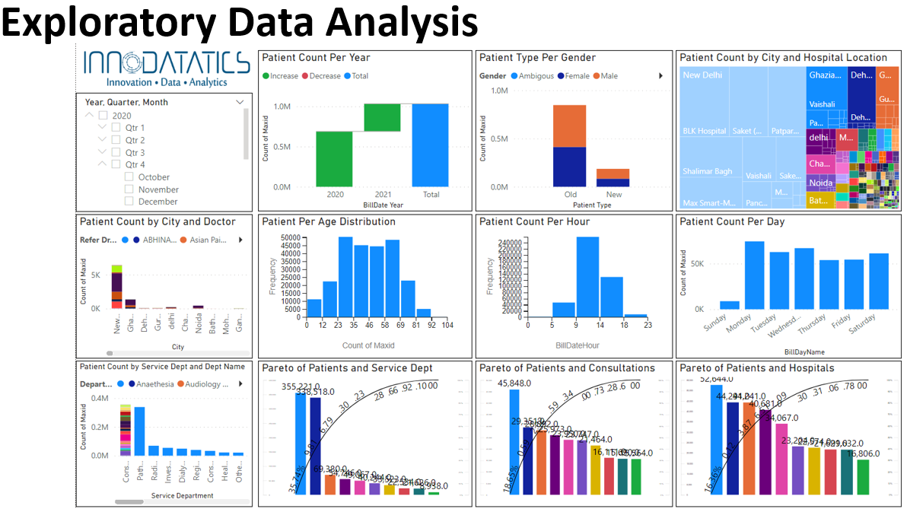
Outputs of the Deployed Model
Outputs of
Universal Sentence Encoder:

Slide 14
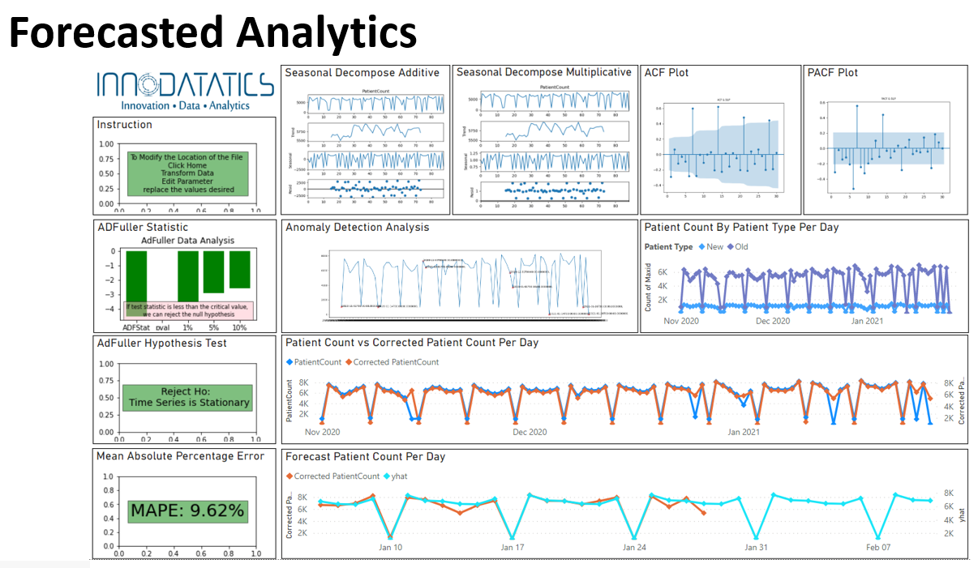
Outputs of the Deployed Model
Outputs of
Universal Sentence Encoder:

Slide 15


